Slide 1
Information-Efficient Representation in Reinforcement Learning: A Unified Perspective
②
Global–Local Decomposition of Contextual
Representations in Meta-Reinforcement Learning
①
③
Compact Goal Representation Learning via Information Bottleneck
Multiagent Reinforcement Learning With
Graphical Mutual Information Maximization
④
⑤
Long-Term Feature Extraction via Frequency
Prediction for Efficient Reinforcement Learning
Neighboring State-Aware Policy for Deep
Reinforcement Learning
CPS Computational Learning Laboratory
1

Slide 2
①
InfoGoal explicitly adopts the IB framework;.
GLOBEX introduces mutual information constraints.
MARGIN learns communication features by maximizing graph mutual information.
SPF analyzes the mutual information rel between Fourier domain features and policy performance.
NS-Aware Policy implicitly preserves information dependencies by modeling temporal sequences.
Compact Goal Representation Learning via Information Bottleneck
②
Global–Local Decomposition of Contextual
Representations in Meta-Reinforcement Learning
Information metrics serve as a crucial tool for optimizing representations.
③
Multiagent Reinforcement Learning With
Graphical Mutual Information Maximization
Representation learning is key to enhancing reinforcement learning performance.
④
Compression targets represent a balance between task-relevant and irrelevant information.
Global-local decoupling enhances the expressive power of task representations.
Fourier prediction modeling relies on long-term data to enhance the representativeness of long-term projections.
Graph structures enhance feature coordination among multi-agents.
Neighborhood state sequences combined with decision-making capture richer temporal features.
Long-Term Feature Extraction via Frequency
Prediction for Efficient Reinforcement Learning
⑤
Neighboring State-Aware Policy for Deep
Reinforcement Learning
CPS Computational Learning Laboratory
2

Slide 3

Paper 1
Compact Goal Representation Learning via Information Bottleneck
in Goal-Conditioned Reinforcement Learning
Qiming Zou and Einoshin Suzuki
This paper was published in: IEEE Transactions on Neural Networks and Learning Systems (IF: 8.9)
Published Time: 2025
Reference: Q. Zou and E. Suzuki, "Compact Goal Representation Learning via Information Bottleneck in Goal-Conditioned Reinforcement Learning," in IEEE Transactions on Neural Networks and Learning Systems, vol. 36, no. 2, pp. 2368-2381, Feb. 2025, doi: 10.1109/TNNLS.2023.3344880.
CPS Computational Learning Laboratory
3

Slide 4
01
Problem Description
02
Method Design
03
Experiment Results
Contents
04
Conclusion
CPS Computational Learning Laboratory
4

Slide 5
Problem Description
Challenge:
Goal-Conditioned Reinforcement Learning (GCRL) agents overfit to irrelevant goal information, leading to poor generalization to unseen goals.
Reward signals are sparse and delayed, making it difficult to extract dense supervision for goal representation learning.
Method:
Proposes InfoGoal, a self-supervised information bottleneck framework that learns compact yet sufficient goal representations.
Defines an intrinsic reward based on representation distance in latent space, guiding goal-oriented exploration under sparse rewards.
CPS Computational Learning Laboratory
5

Slide 6
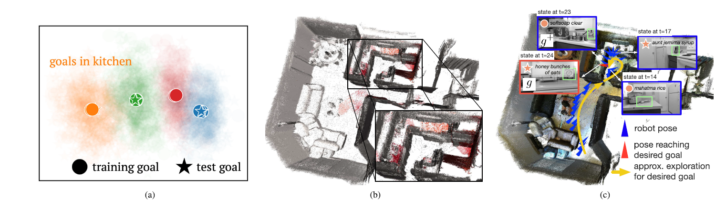
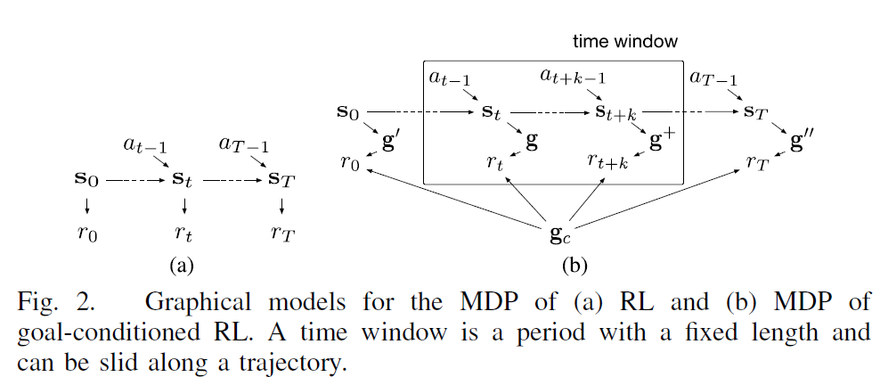
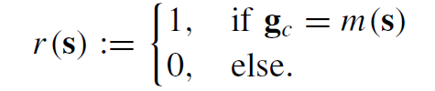
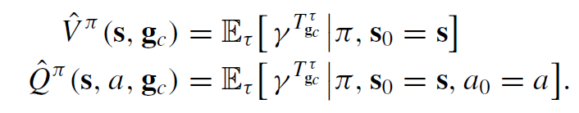
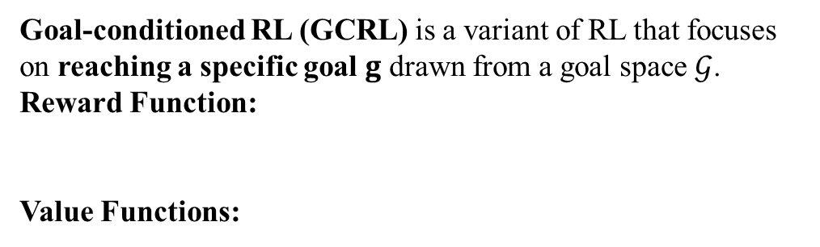
Problem Description
Motivation of InfoGoal:
Goal-Conditioned RL:
Goal-conditioned RL (GCRL) is a variant of RL that focuses on reaching a specific goal $g$ drawn from a goal space $𝒢$.
Reward Function:
Value Functions:
CPS Computational Learning Laboratory
6

Slide 7
01
Problem Description
02
Method Design
03
Experiment Results
Contents
04
Conclusion
CPS Computational Learning Laboratory
7

Slide 8
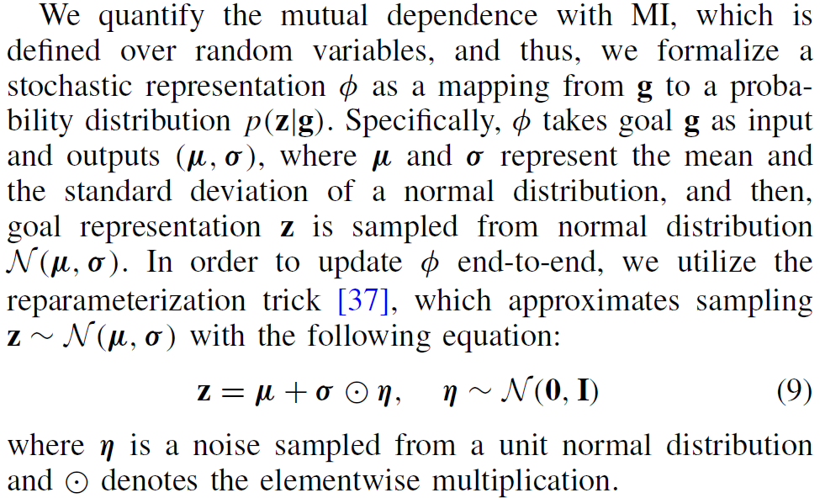
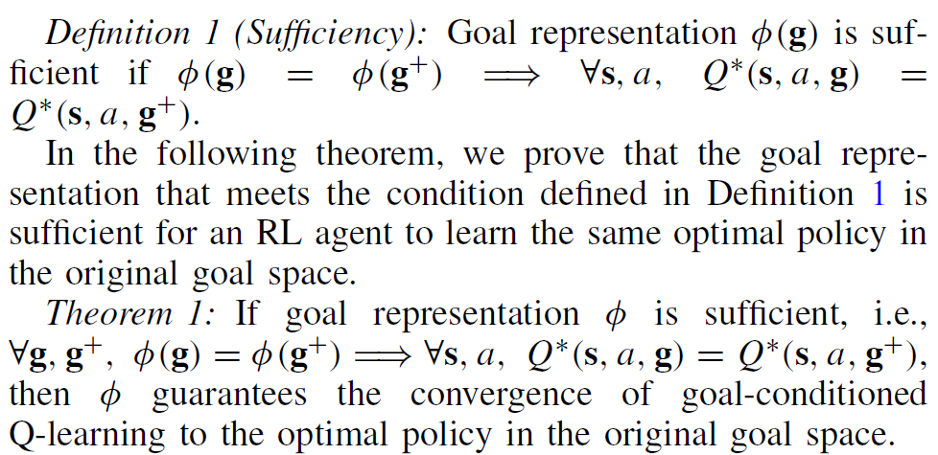
Method Design
1 Sufficient Goal Representation
CPS Computational Learning Laboratory
8

Slide 9
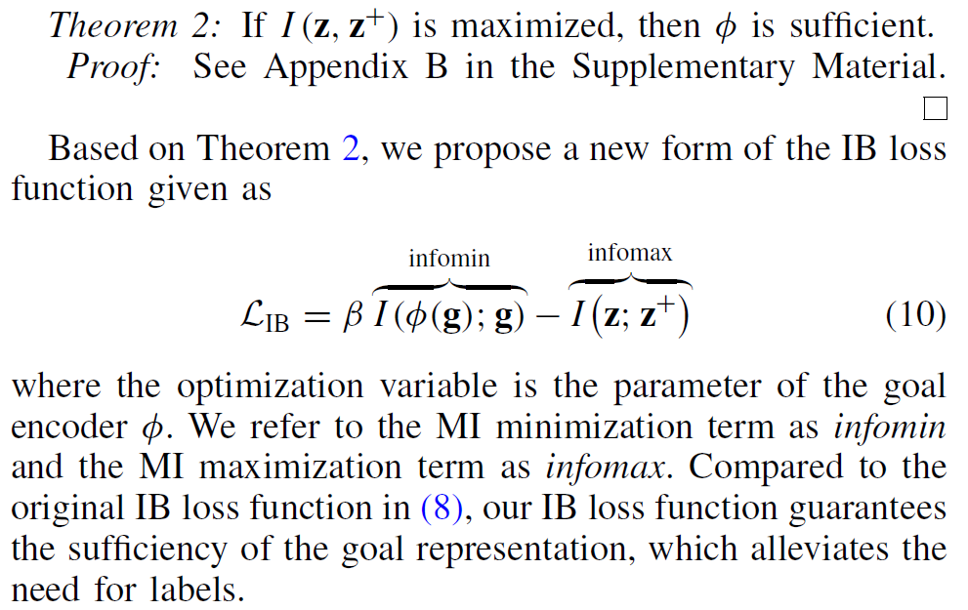
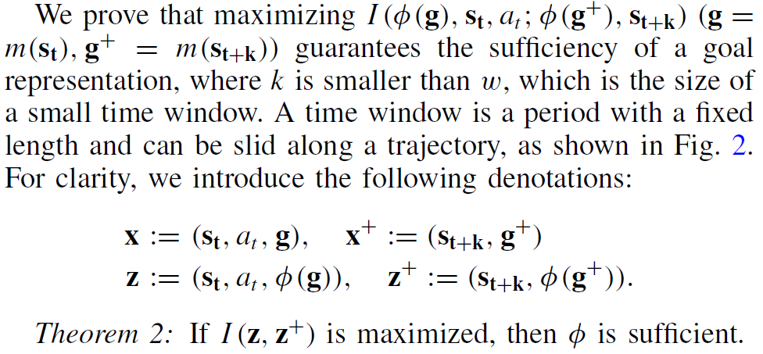
Method Design
2 Information Bottleneck Loss
CPS Computational Learning Laboratory
9

Slide 10
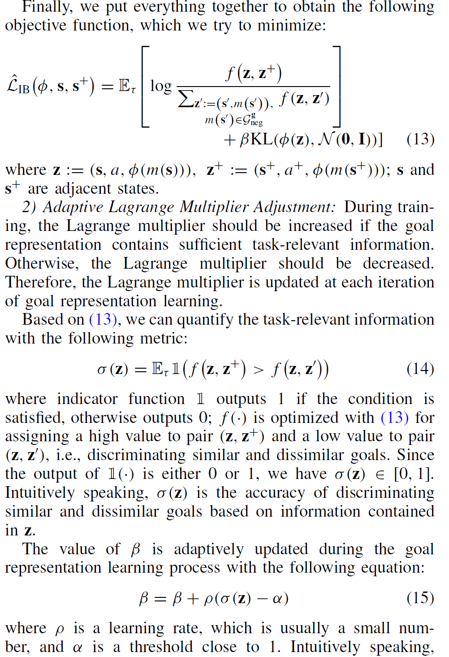
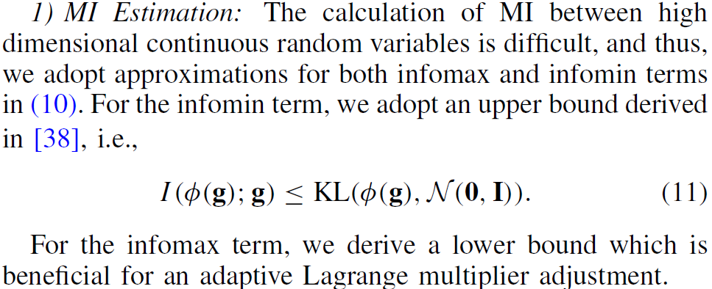
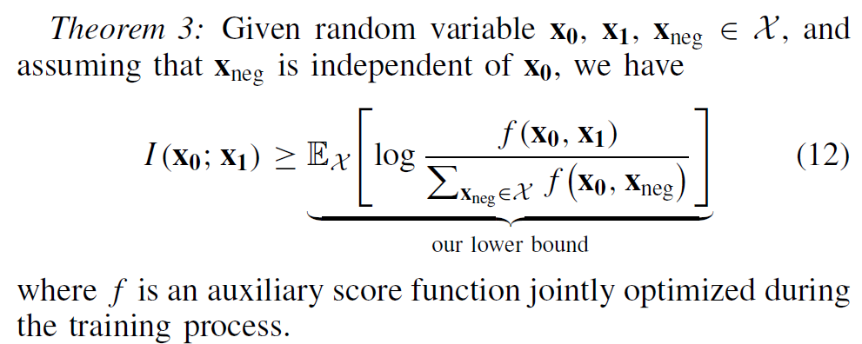
Method Design
3 MI Estimation and Adaptive Lagrange Multiplier Adjustment
CPS Computational Learning Laboratory
10

Slide 11
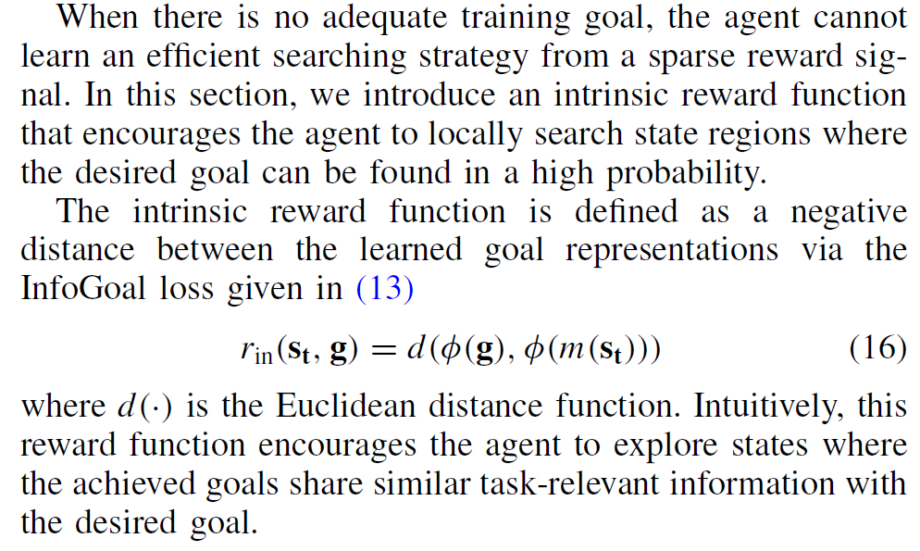
Method Design
3 Local Searching With Intrinsic Reward
CPS Computational Learning Laboratory
11

Slide 12
01
Problem Description
02
Method Design
03
Experiment Results
Contents
04
Conclusion
CPS Computational Learning Laboratory
12

Slide 13
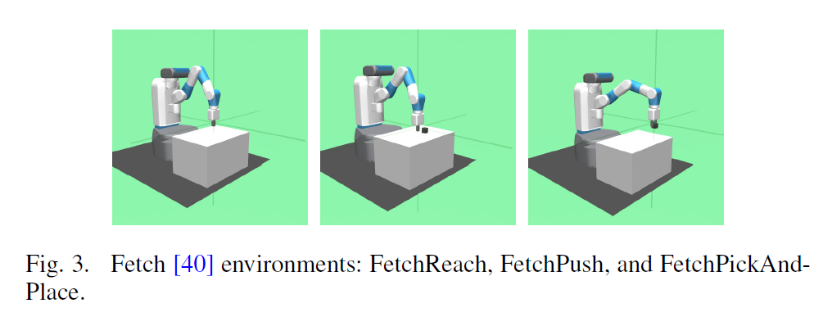
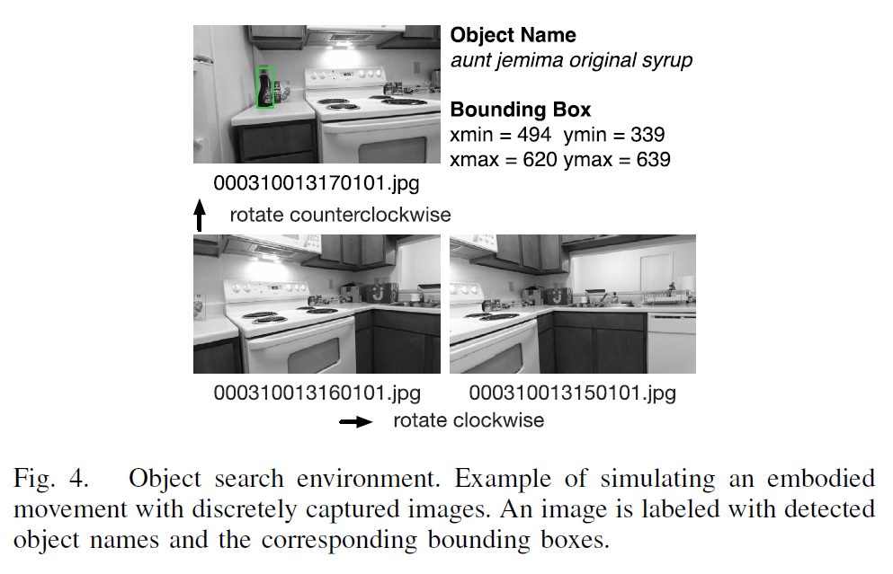
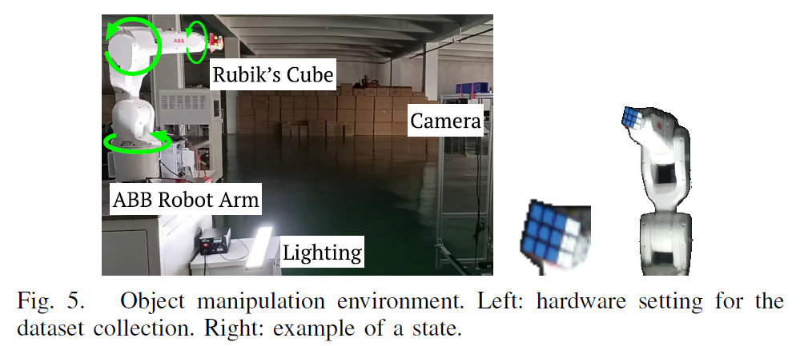
Experiment Results
Environments
CPS Computational Learning Laboratory
13

Slide 14
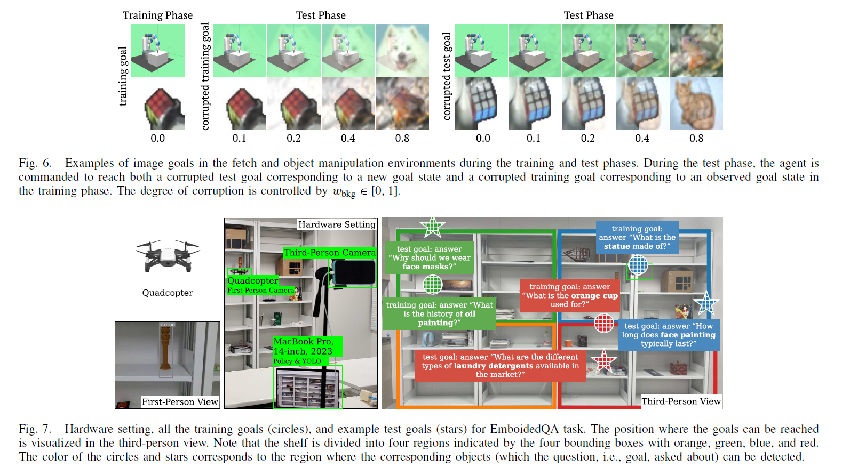
Experiment Results
Environments
CPS Computational Learning Laboratory
14

Slide 15
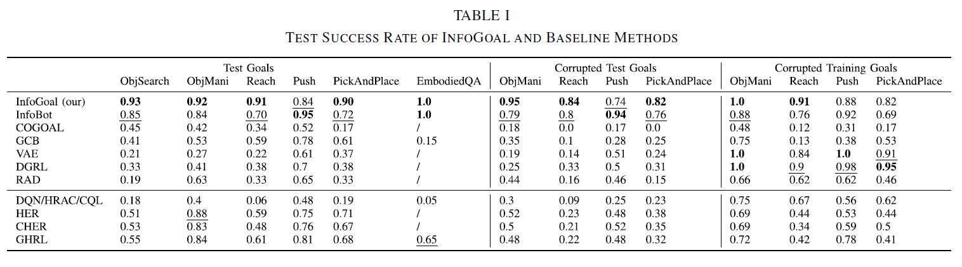
Experiment Results
CPS Computational Learning Laboratory
15

Slide 16
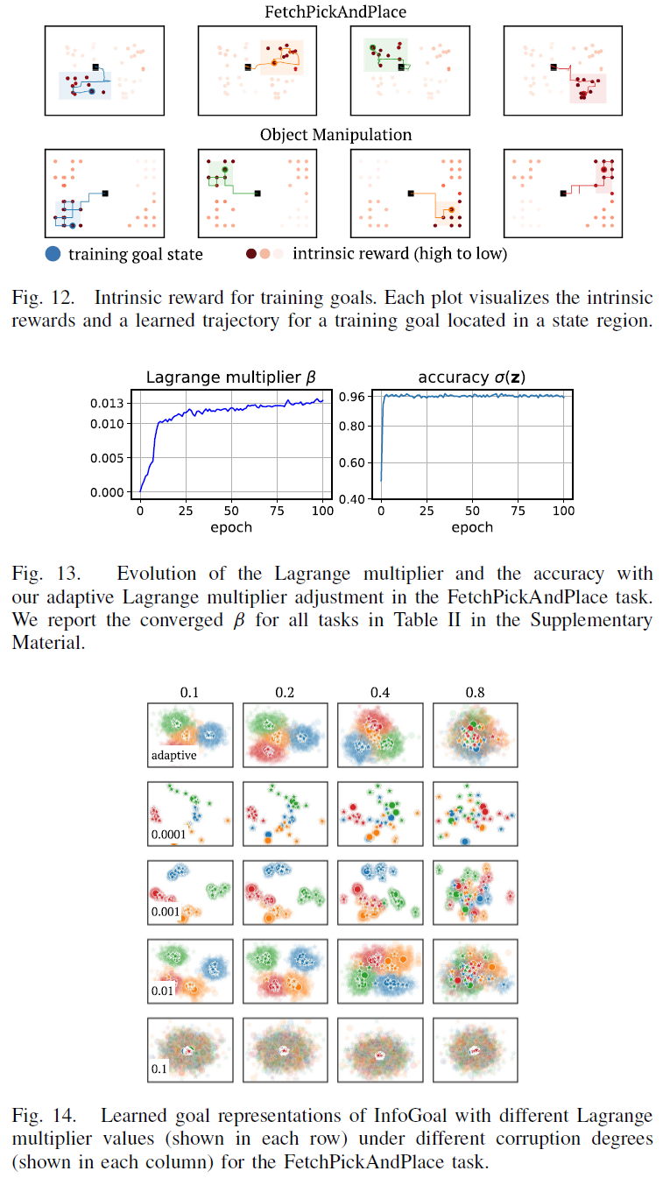
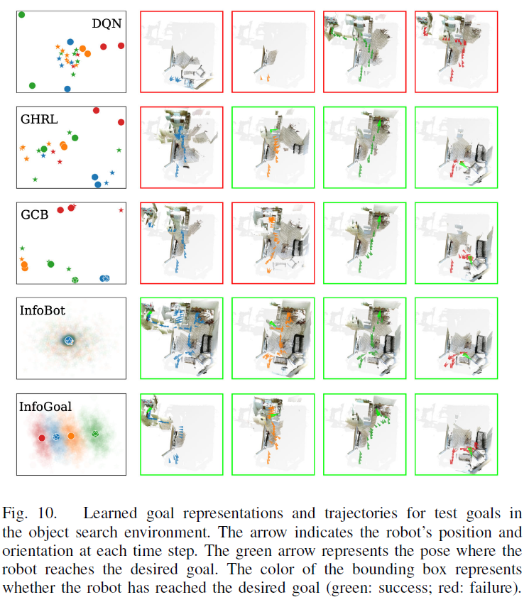
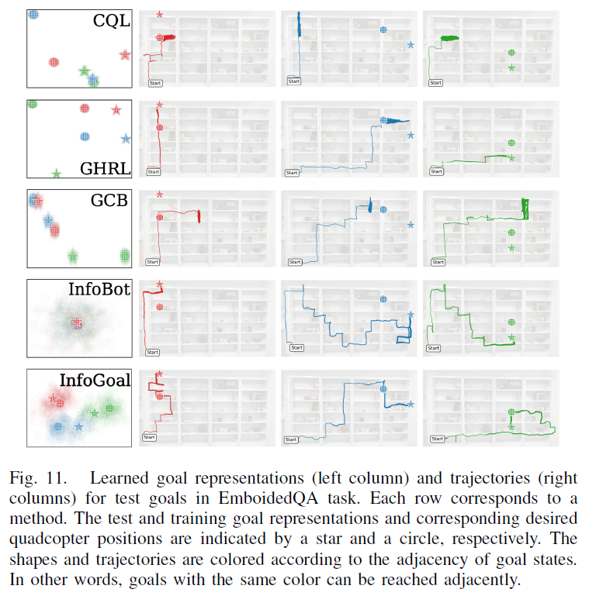
Experiment Results
CPS Computational Learning Laboratory
16

Slide 17
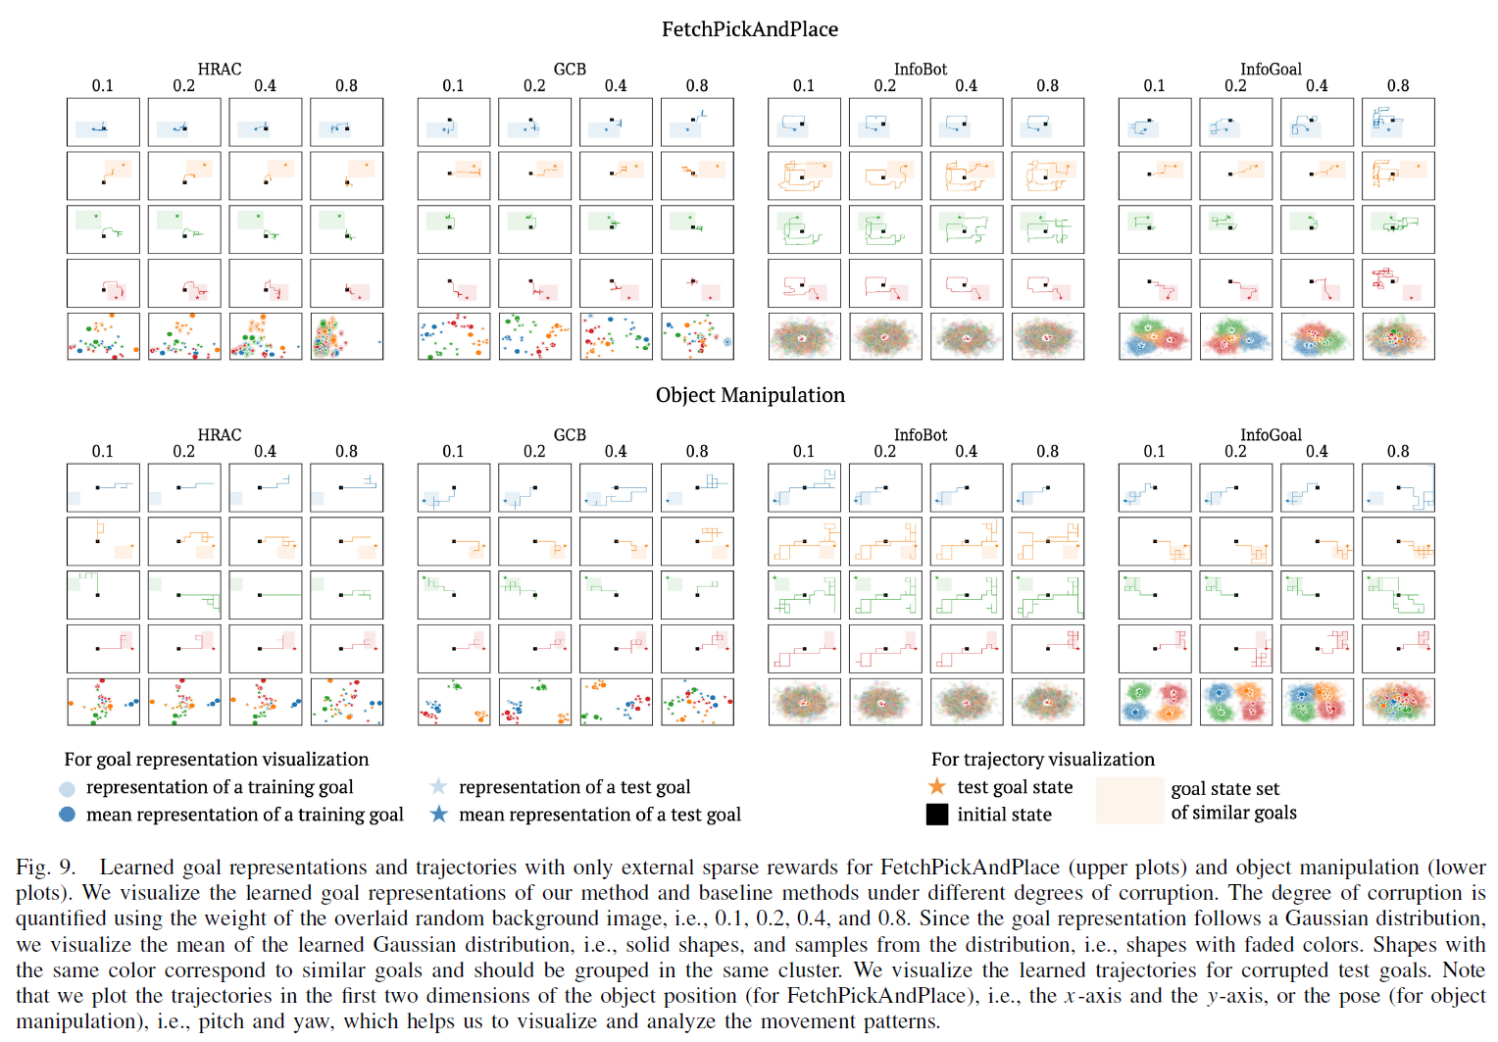
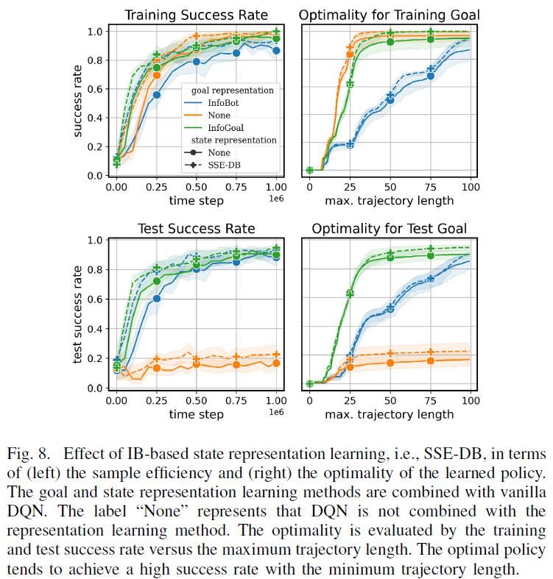
Experiment Results
CPS Computational Learning Laboratory
17

Slide 18
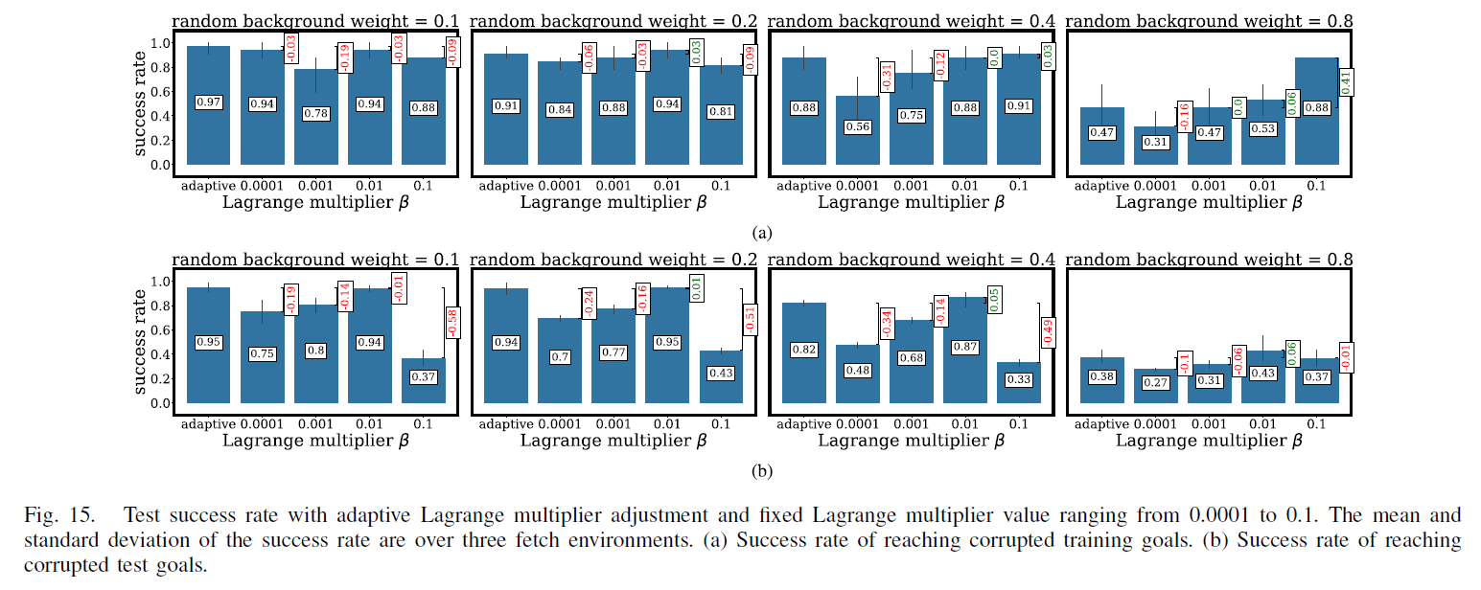
Experiment Results
CPS Computational Learning Laboratory
18

Slide 19
01
Problem Description
02
Method Design
03
Experiment Results
Contents
04
Conclusion
CPS Computational Learning Laboratory
19
CPS Computational Learning Laboratory
2
18

Slide 20
Conclusion
①
The proposed InfoGoal framework—a self-supervised information bottleneck approach for goal-conditioned reinforcement learning—learns compact yet task-relevant goal representations, achieving superior generalization, sample efficiency, and training stability.
The integration of adaptive information compression, self-supervised objectives, and intrinsic rewards enables agents to learn effectively under sparse or delayed rewards, capturing task semantics while filtering irrelevant goal noise..
②
Extensive experiments on multiple GCRL benchmarks (Fetch, Object Search, Object Manipulation, Embodied QA) demonstrate that InfoGoal outperforms state-of-the-art methods (e.g., InfoBot, COGOAL) in both success rate and policy robustness.
Future work will extend the framework to multi-agent goal-conditioned RL and explore hierarchical bottleneck mechanisms for better scalability in visual and real-world robotic control tasks
CPS Computational Learning Laboratory
20

Slide 21
Paper 2
Global–Local Decomposition of Contextual Representations
in Meta-Reinforcement Learning
Nelson Ma, Junyu Xuan, Senior Member, IEEE, Guangquan Zhang, and Jie Lu, Fellow, IEEE
This paper was published in: IEEE Transactions on Cybernetics (IF: 10.5)
Published Time: 2025
Reference: N. Ma, J. Xuan, G. Zhang and J. Lu, "Global–Local Decomposition of Contextual Representations in Meta-Reinforcement Learning," in IEEE Transactions on Cybernetics, vol. 55, no. 3, pp. 1277-1287, March 2025, doi: 10.1109/TCYB.2025.3533035.
CPS Computational Learning Laboratory
21

Slide 22
01
Problem Description
02
Method Design
03
Experiment Results
Contents
04
Conclusion
CPS Computational Learning Laboratory
22

Slide 23
Problem Description
Challenge:
In Meta-Reinforcement Learning (Meta-RL), agents must quickly adapt to new tasks based on limited experience. However, existing context-based methods often rely on a single context embedding, which struggles to capture both global task structure and local temporal variations.
The limitation leads to slow adaptation and poor generalization across task distributions, especially under non-stationary or multi-modal environments.
Method:
Proposes GLOBEX, a Global–Local Decomposition framework that splits task representations into a global variable (capturing shared structure) and a local variable (capturing short-term dynamics).
Incorporates a mutual information constraint to ensure the two embeddings are disentangled yet complementary, enabling efficient adaptation across tasks.
CPS Computational Learning Laboratory
23

Slide 24
01
Problem Description
02
Method Design
03
Experiment Results
Contents
04
Future Work
CPS Computational Learning Laboratory
24
Notes:
研究现状

Slide 25
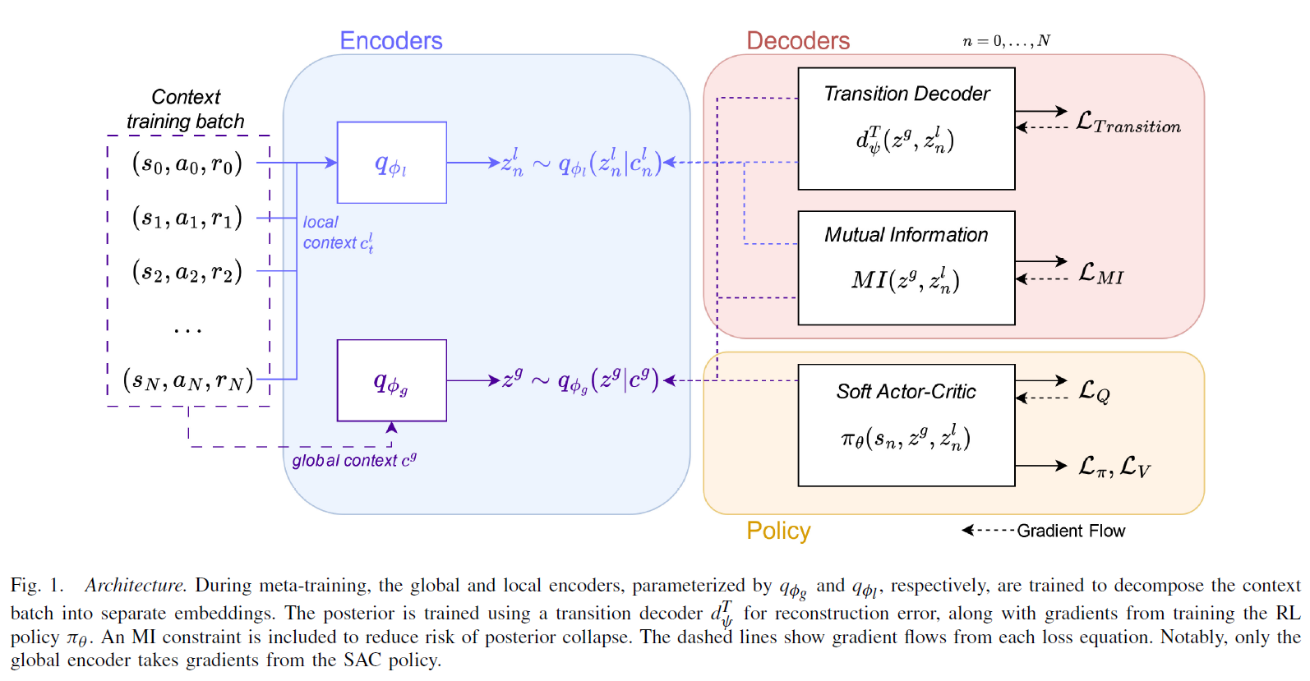
Method Design
CPS Computational Learning Laboratory
25

Slide 26
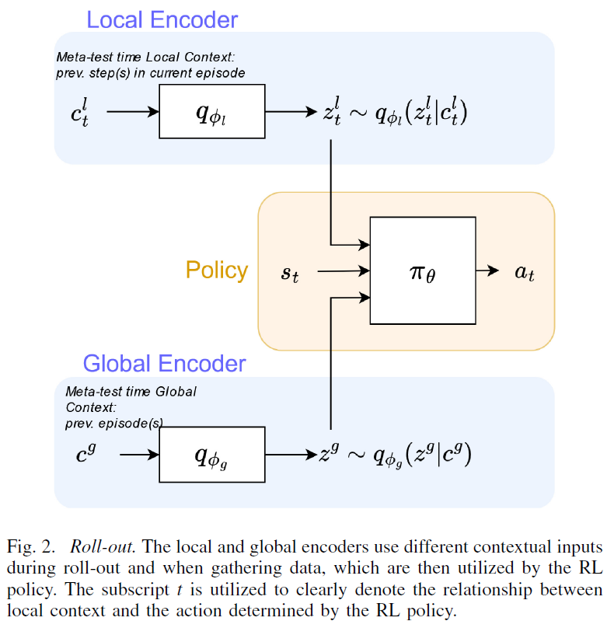
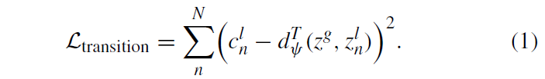
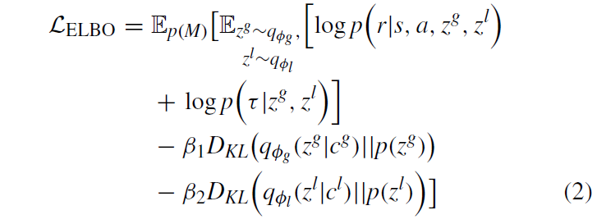
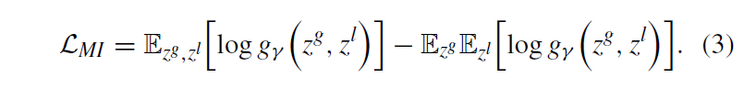
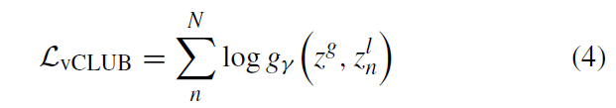
Method Design
1 Global–Local Embeddings
CPS Computational Learning Laboratory
26

Slide 27
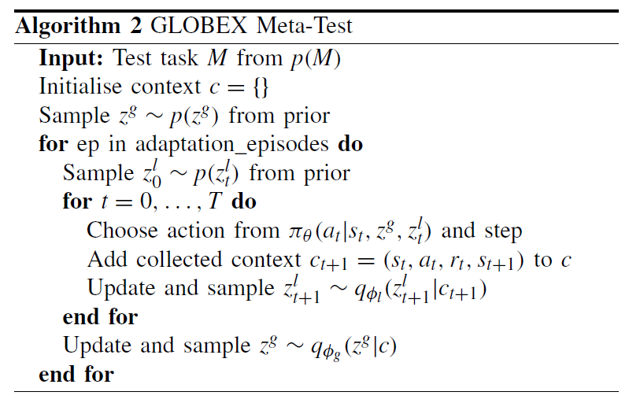
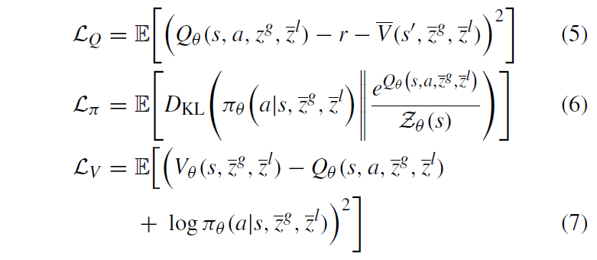
Method Design
2 Implementation
CPS Computational Learning Laboratory
27

Slide 28
01
Problem Description
02
Method Design
03
Experiment Results
Contents
04
Conclusion
CPS Computational Learning Laboratory
28

Slide 29
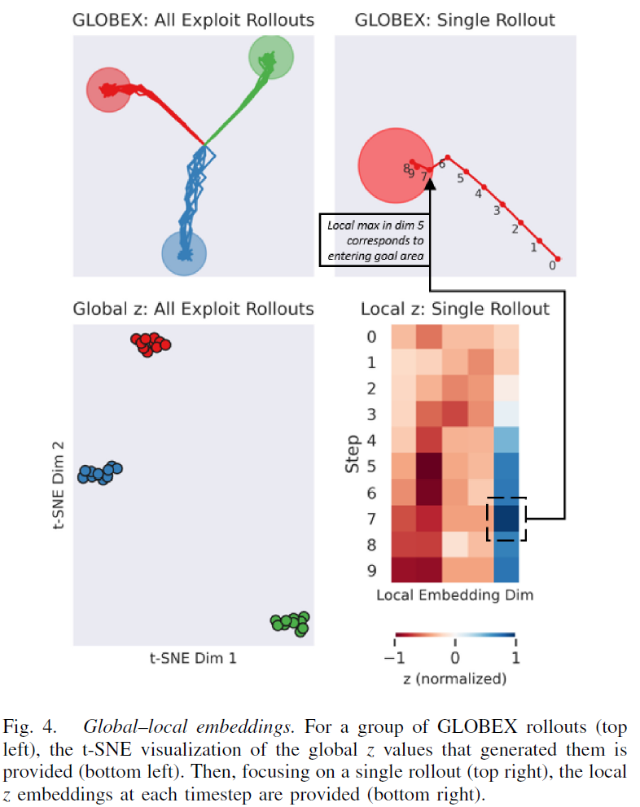
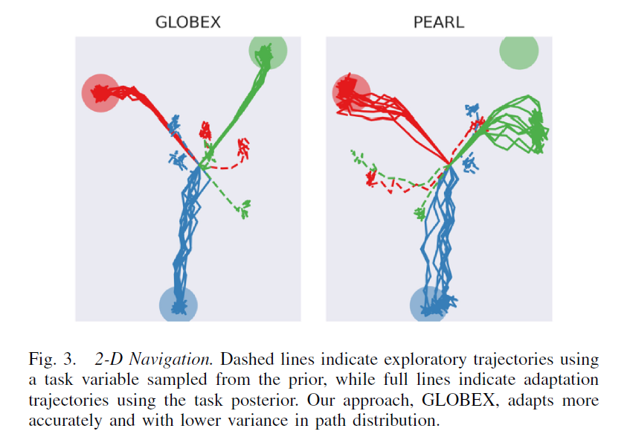
Experiment Results
1 Behavioral Impact of Local Embedding
CPS Computational Learning Laboratory
29

Slide 30
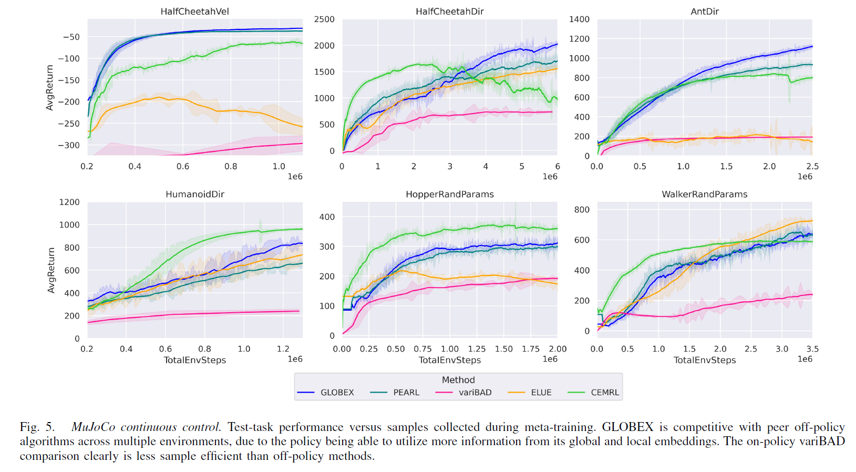
Experiment Results
2 Performance and Sample Efficiency
CPS Computational Learning Laboratory
30

Slide 31
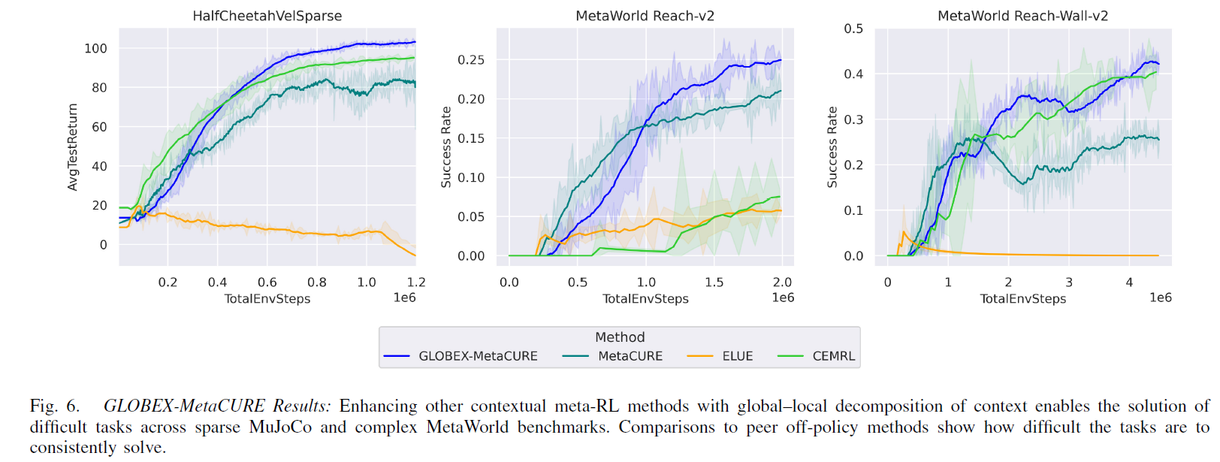
Experiment Results
3 Global–Local Decomposition With Exploration
CPS Computational Learning Laboratory
31

Slide 32
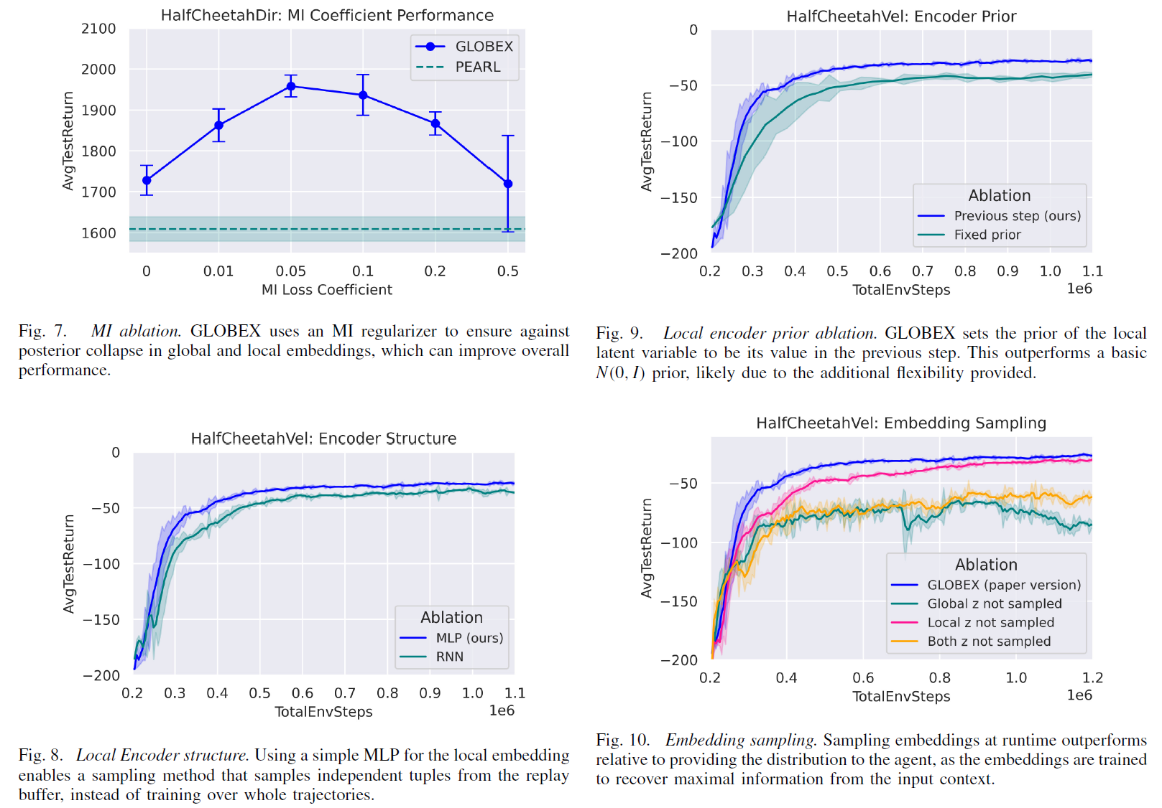
Experiment Results
4 Ablations
CPS Computational Learning Laboratory
32

Slide 33
01
Problem Description
02
Method Design
03
Experiment Results
Contents
04
Conclusion
CPS Computational Learning Laboratory
33
CPS Computational Learning Laboratory
2
18

Slide 34
Conclusion
①
The proposed GLOBEX framework—decomposing task context into global and local representations—effectively improves meta-reinforcement learning by enabling agents to capture shared task structure and short-term dynamics simultaneously.
The integration of mutual information constraints and off-policy optimization ensures that global and local embeddings remain disentangled yet complementary, leading to faster adaptation and higher sample efficiency across diverse task distributions..
②
Extensive experiments on benchmark environments demonstrate that GLOBEX outperforms prior meta-RL methods such as PEARL and MetaCURE in both adaptation speed and generalization performance.
Future work will explore hierarchical global-local decomposition for large-scale tasks and integrate multi-agent meta-learning to further enhance coordination and robustness in non-stationary environment.
CPS Computational Learning Laboratory
34

Slide 35
Paper 3
Multiagent Reinforcement Learning With Graphical
Mutual Information Maximization
Shifei Ding, Wei Du, Ling Ding, Jian Zhang, Lili Guo, and Bo An, Member, IEEE
This paper was published in: IEEE Transactions on Neural Networks and Learning Systems (IF: 8.9)
Published Time: 2025
Reference: S. Ding, W. Du, L. Ding, J. Zhang, L. Guo and B. An, "Multiagent Reinforcement Learning With Graphical Mutual Information Maximization," in IEEE Transactions on Neural Networks and Learning Systems, vol. 36, no. 11, pp. 19515-19524, Nov. 2025, doi: 10.1109/TNNLS.2023.3243557.
CPS Computational Learning Laboratory
35

Slide 36
01
Problem Description
02
Method Design
03
Experiment Results
Contents
04
Conclusion
CPS Computational Learning Laboratory
36

Slide 37
Problem Description
Challenge:
In multi-agent reinforcement learning (MARL), effective communication and coordination among agents are crucial for accomplishing cooperative tasks.
However, existing Graph Neural Network (GNN)-based MARL approaches often aggregate neighbor information blindly, ignoring the topological dependencies between agents.
Such naive aggregation leads to information redundancy, low-quality feature representations, and unstable cooperation in large-scale or partially observable environments..
Method:
Proposes MARGIN, a GNN-based MARL framework that introduces Graphical Mutual Information (MI) Maximization to enhance inter-agent communication.
Maximizes the MI between neighbor agent features and topological relationships, ensuring that the learned representations capture both feature relevance and structural consistency..
CPS Computational Learning Laboratory
37

Slide 38
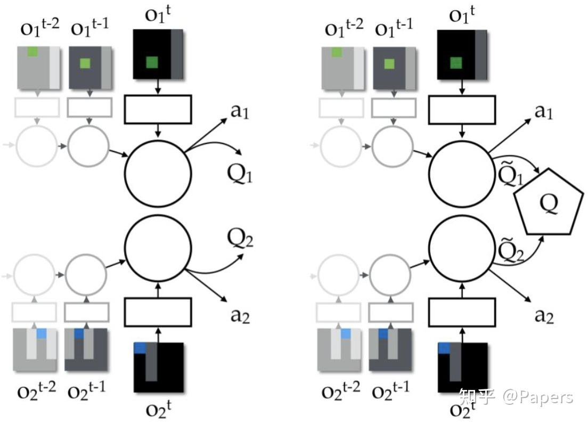
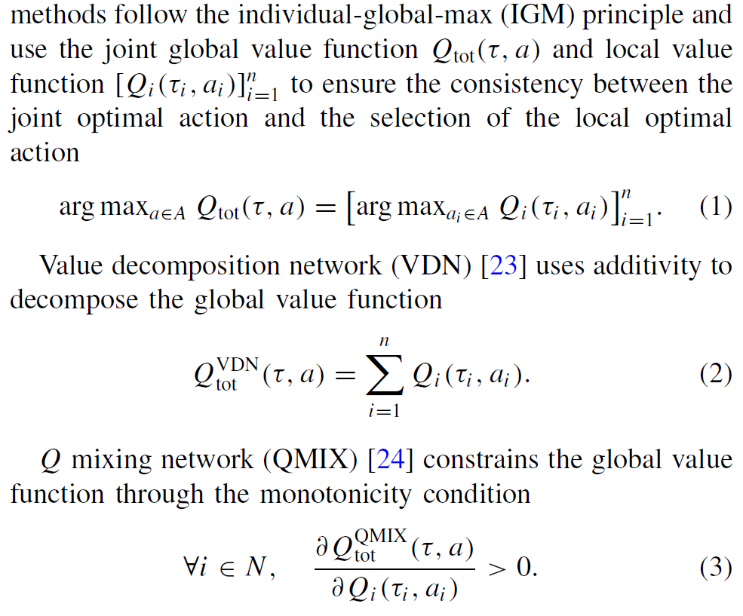
Problem Description
Value Decomposition
CPS Computational Learning Laboratory
38

Slide 39
01
Problem Description
02
Method Design
03
Experiment Results
Contents
04
Conclusion
CPS Computational Learning Laboratory
39

Slide 40
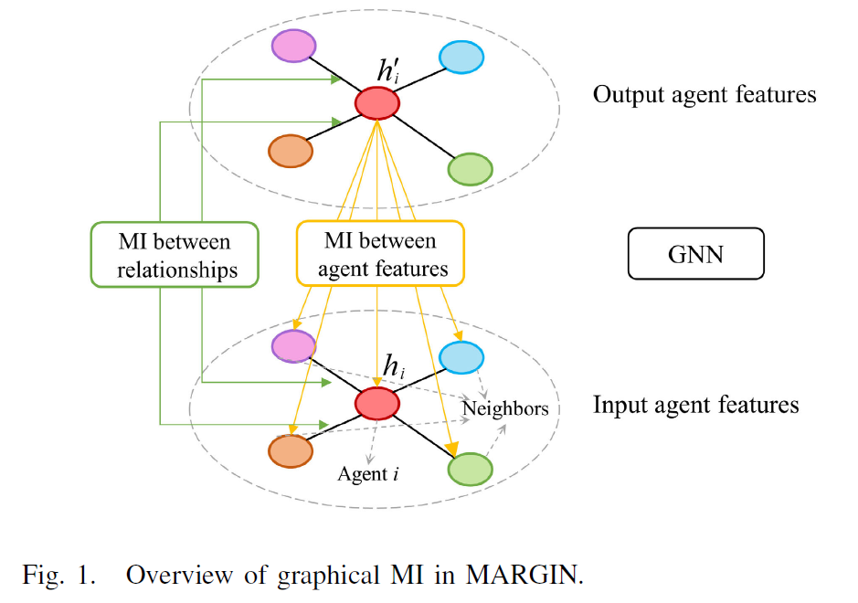
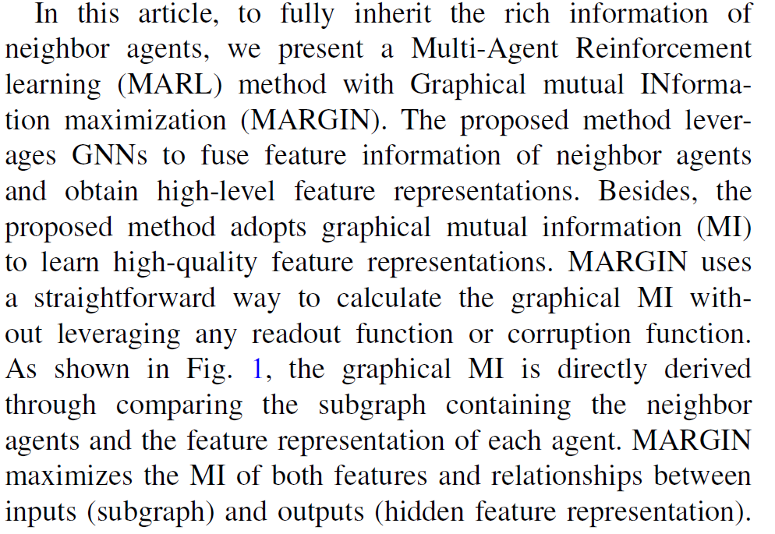
Method Design
1 Problem Formulation
CPS Computational Learning Laboratory
40

Slide 41
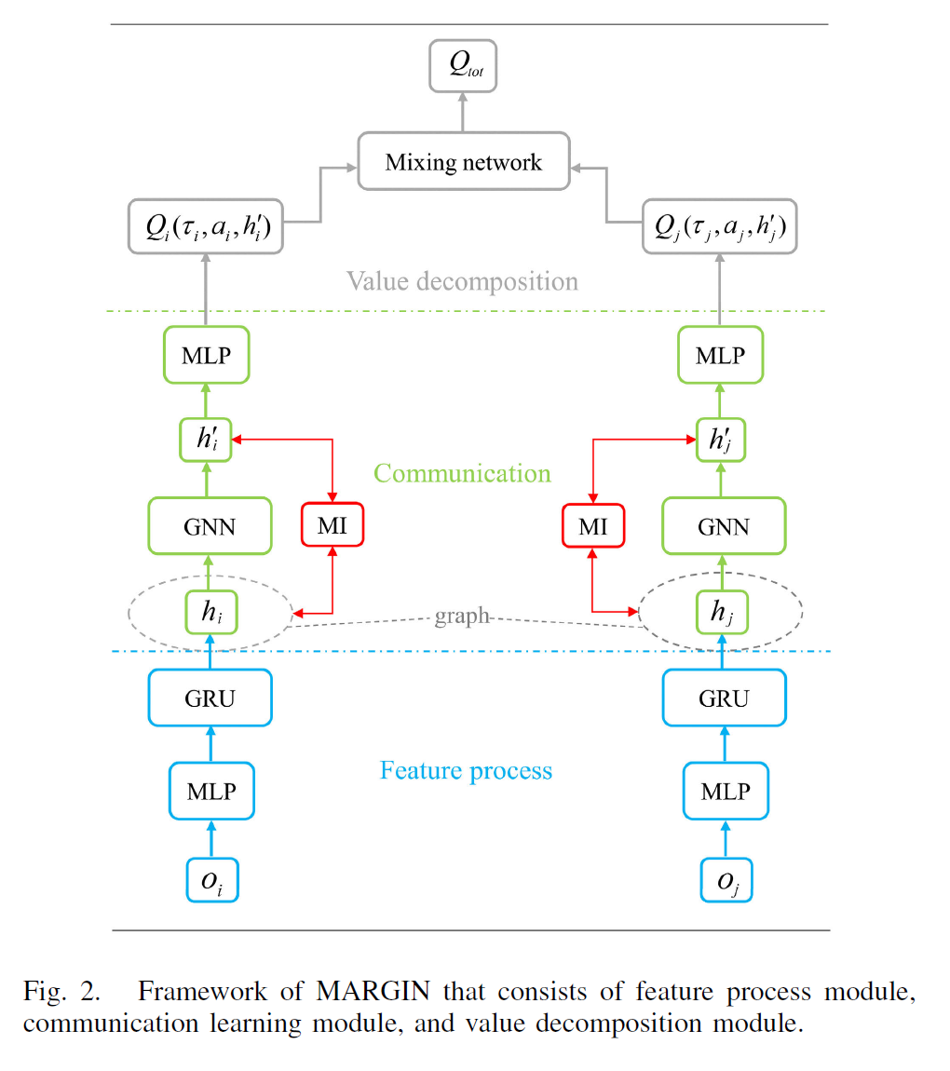
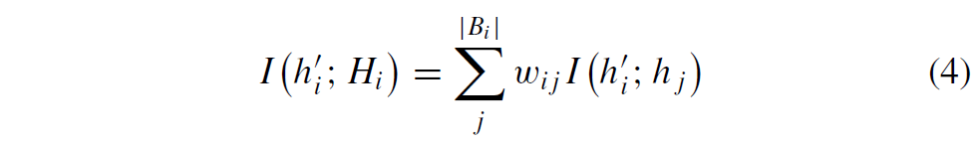
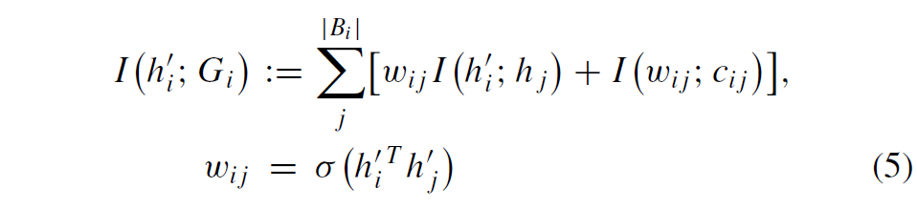
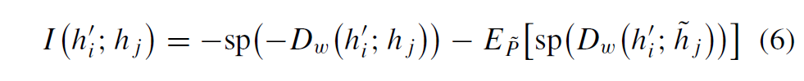
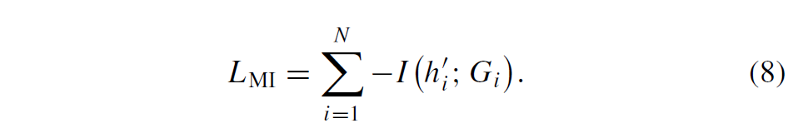
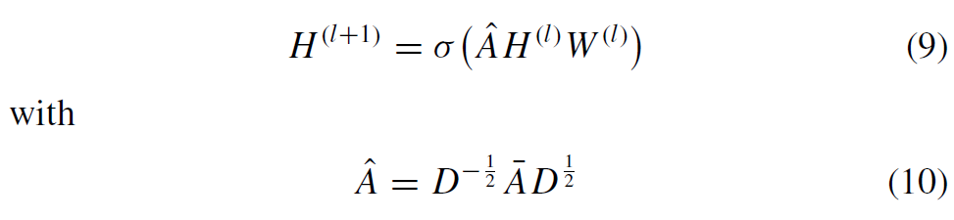
Method Design
2 Framework of MARGIN & 3 Communication Learning
CPS Computational Learning Laboratory
41

Slide 42
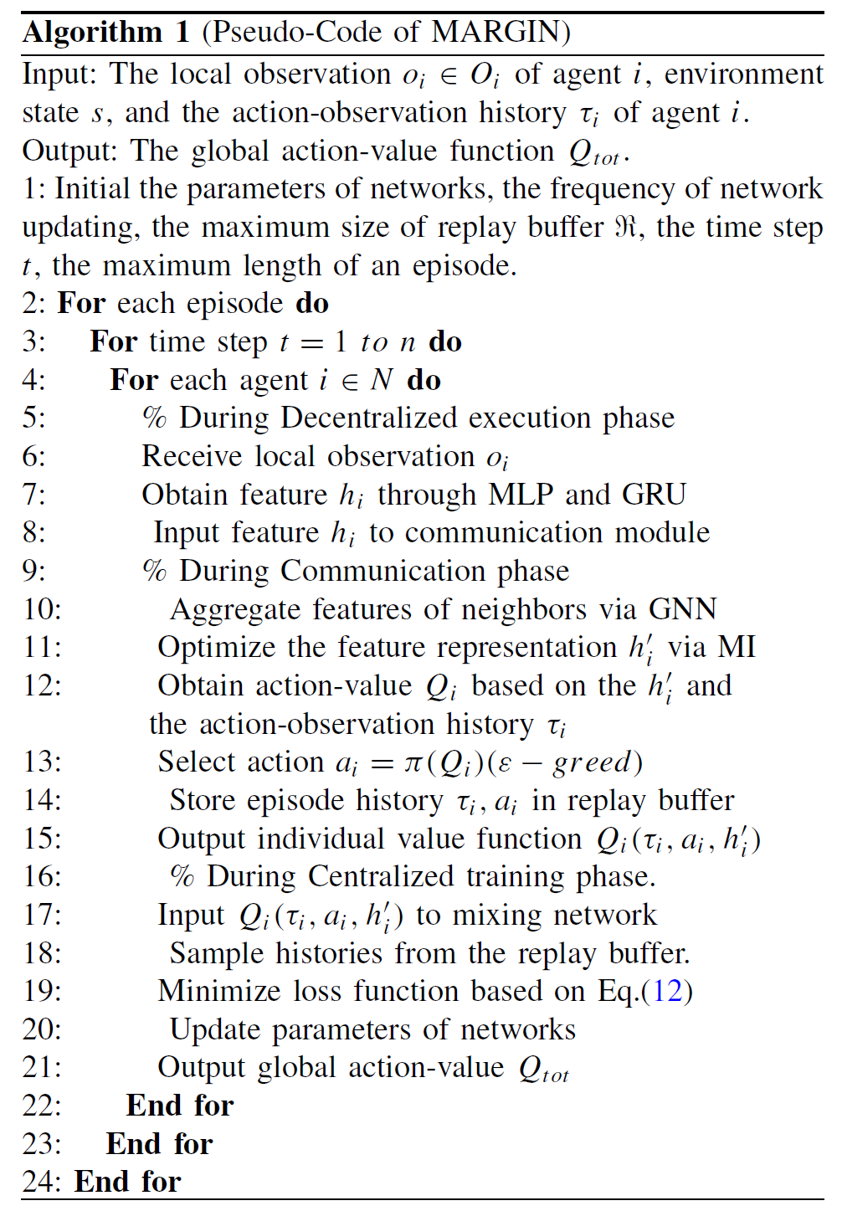
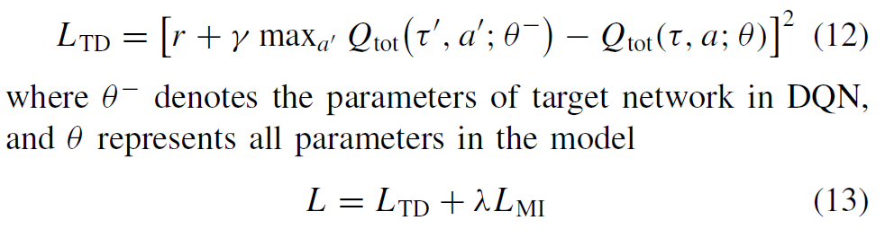
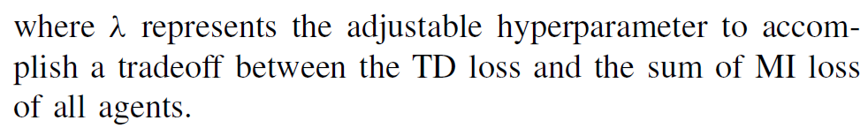

Method Design
4 Overall Optimization Objective
CPS Computational Learning Laboratory
42

Slide 43
01
Problem Description
02
Method Design
03
Experiment Results
Contents
04
Conclusion
CPS Computational Learning Laboratory
43

Slide 44



Experiment Results
1 MAgent
CPS Computational Learning Laboratory
44

Slide 45



Experiment Results
2 SMAC
CPS Computational Learning Laboratory
45

Slide 46


Experiment Results
2 Notations and Hyperparameters
CPS Computational Learning Laboratory
46

Slide 47
01
Problem Description
02
Method Design
03
Experiment Results
Contents
04
Conclusion
CPS Computational Learning Laboratory
47
CPS Computational Learning Laboratory
2
18

Slide 48
Conclusion
①
The proposed MARGIN framework introduces graphical mutual information maximization into multi-agent reinforcement learning to enhance inter-agent communication and coordinated policy learning.
By modeling the multi-agent system as a graph structure and maximizing the mutual information between neighboring agents’ features and their topological dependencies, MARGIN achieves more informative representations, leading to better cooperation stability, higher sample efficiency, and improved team performance in complex environments
②
Future work will extend this framework to heterogeneous agent systems and explore hierarchical or dynamic graph structures to adaptively adjust inter-agent connectivity under varying environmental dynamics.
CPS Computational Learning Laboratory
48

Slide 49
Paper 4
Long-Term Feature Extraction via Frequency Prediction
for Efficient Reinforcement Learning
Jie Wang, Senior Member, IEEE, Mingxuan Ye, Yufei Kuang, Rui Yang, Wengang Zhou, Senior Member, IEEE, Houqiang Li, Fellow, IEEE, and Feng Wu, Fellow, IEEE
This paper was published in: IEEE Transactions on Pattern Analysis and Machine Intelligence (IF: 18.6)
Published Time: 2025
Reference: J. Wang et al., "Long-Term Feature Extraction via Frequency Prediction for Efficient Reinforcement Learning," in IEEE Transactions on Pattern Analysis and Machine Intelligence, vol. 47, no. 4, pp. 3094-3110, April 2025, doi: 10.1109/TPAMI.2025.3529264..
CPS Computational Learning Laboratory
49

Slide 50
01
Problem Description
02
Method Design
03
Experiment Results
Contents
04
Conclusion
CPS Computational Learning Laboratory
50

Slide 51
Problem Description
Challenge:
Deep reinforcement learning (RL) often struggles with low sample efficiency, as agents require large amounts of training data to learn effective long-term decision-making strategies.
Existing predictive representation methods rely on multi-step state prediction in the time domain, which suffers from error accumulation, limited prediction horizons, and failure to capture global temporal structure.
Method:
Proposes State Sequences Prediction via Fourier Transform (SPF), a novel frequency-domain representation learning method that extracts long-term structural information by predicting the Fourier transform of infinite-step future state sequences.
Reformulates the Fourier prediction objective as a recursive temporal-difference (TD)-style loss, enabling simple and efficient implementation without storing full trajectories.
CPS Computational Learning Laboratory
51

Slide 52


Problem Description
Goal-Conditioned Reinforcement Learning
CPS Computational Learning Laboratory
52

Slide 53



Problem Description
Discrete-Time Fourier Transform
CPS Computational Learning Laboratory
53

Slide 54
01
Problem Description
02
Method Design
03
Experiment Results
Contents
04
Conclusion
CPS Computational Learning Laboratory
54

Slide 55


Method Design
1 Structural Information in State Sequences
CPS Computational Learning Laboratory
55

Slide 56



Method Design
1 Structural Information in State Sequences
Policy Performance Distinction via State Sequences
CPS Computational Learning Laboratory
56

Slide 57

Method Design
1 Structural Information in State Sequences
Asymptotic Periodicity of States in MDP
CPS Computational Learning Laboratory
57

Slide 58


Method Design
2 Learning via Frequency Domain of State Sequences
CPS Computational Learning Laboratory
58

Slide 59




Method Design
3 Learning Objective of SPF
CPS Computational Learning Laboratory
59

Slide 60


Method Design
4 Improved Objective With Temporal Supervision
CPS Computational Learning Laboratory
60

Slide 61

Method Design
5 Network Architecture of SPFT
CPS Computational Learning Laboratory
61

Slide 62
01
Problem Description
02
Method Design
03
Experiment Results
Contents
04
Conclusion
CPS Computational Learning Laboratory
62

Slide 63

Experiment Results
1 Comparative Experiments
CPS Computational Learning Laboratory
63

Slide 64

Experiment Results
1 Comparative Experiments
CPS Computational Learning Laboratory
64

Slide 65

Experiment Results
1 Comparative Experiments
CPS Computational Learning Laboratory
65

Slide 66


Experiment Results
2 Ablation Study
CPS Computational Learning Laboratory
66

Slide 67


Experiment Results
2 Ablation Study
CPS Computational Learning Laboratory
67

Slide 68

Experiment Results
3 Visualization
CPS Computational Learning Laboratory
68

Slide 69

Experiment Results
3 Visualization
CPS Computational Learning Laboratory
69

Slide 70
01
Problem Description
02
Method Design
03
Experiment Results
Contents
04
Conclusion
CPS Computational Learning Laboratory
70
CPS Computational Learning Laboratory
2
18

Slide 71
Conclusion
①
The proposed State Sequences Prediction via Fourier Transform (SPF) framework introduces a novel frequency-domain perspective for reinforcement learning representation.
By predicting the Fourier transform of future state sequences, the model effectively captures long-term temporal dependencies and global structural patterns, overcoming the limitations of time-domain prediction methods.
The recursive TD-style frequency loss enables lightweight implementation and improved sample efficiency, leading to faster convergence and better foresight in complex environments.
②
Future work will explore integrating frequency-domain representation learning with hierarchical RL and model-based policy optimization, as well as applying the approach to visual and multi-agent settings where long-term reasoning is critical.
CPS Computational Learning Laboratory
71

Slide 72
Paper 5
Neighboring State-Aware Policy for Deep
Reinforcement Learning
Meng Xu, Xinhong Chen, Guanyi Zhao, Zihao Wen, Weiwei Fu, and Jianping Wang, Fellow, IEEE
This paper was published in: IEEE Transactions on Neural Networks and Learning Systems (IF: 8.9)
Published Time: 2025
Reference: M. Xu, X. Chen, G. Zhao, Z. Wen, W. Fu and J. Wang, "Neighboring State-Aware Policy for Deep Reinforcement Learning," in IEEE Transactions on Neural Networks and Learning Systems, vol. 36, no. 10, pp. 18188-18202, Oct. 2025, doi: 10.1109/TNNLS.2025.3581217.
CPS Computational Learning Laboratory
72

Slide 73
01
Problem Description
02
Method Design
03
Experiment Results
Contents
04
Conclusion
CPS Computational Learning Laboratory
73

Slide 74
Problem Description
Challenge:
Most deep reinforcement learning (DRL) algorithms make decisions based solely on the current state, ignoring temporal dependencies and neighboring state transitions.
The short-sighted policy design often results in suboptimal behaviors, such as oscillations or failure to plan for delayed rewards.
Method:
Proposes a Neighboring State-Aware Policy (NSP) framework that explicitly integrates neighboring state sequences into policy learning.
NSP leverages n-step neighboring states (past and future) to construct a temporal neighborhood representation, capturing both local dynamics and transition smoothness.
The method employs a dual-encoder architecture and combines their embeddings through attention-based fusion, enabling temporally consistent and globally optimal policy learning..
CPS Computational Learning Laboratory
74

Slide 75
01
Problem Description
02
Method Design
03
Experiment Results
Contents
04
Future Work
CPS Computational Learning Laboratory
75

Slide 76

Method Design
1 Overview of Our Perspective
CPS Computational Learning Laboratory
76

Slide 77

Method Design
1 Overview of Our Perspective
CPS Computational Learning Laboratory
77

Slide 78

Method Design
2 Training Procedure of Our Perspective
Collecting Samples
CPS Computational Learning Laboratory
78

Slide 79



Method Design
2 Training Procedure of Our Perspective
Updating DRL Models
CPS Computational Learning Laboratory
79

Slide 80

Method Design
3 2-D CNN-Based Approach for Neighboring State
CPS Computational Learning Laboratory
80

Slide 81

Method Design
4 Transformer-Based Approach for Neighboring State
CPS Computational Learning Laboratory
81

Slide 82
01
Problem Description
02
Method Design
03
Experiment Results
Contents
04
Conclusion
CPS Computational Learning Laboratory
82

Slide 83

Experiment Results
1 Experiment Preparation
CPS Computational Learning Laboratory
83

Slide 84


Experiment Results
2 Comparison With SOTA DRL Methods
CPS Computational Learning Laboratory
84

Slide 85

Experiment Results
3 Validation of Our Method Implemented Using a Transformer
CPS Computational Learning Laboratory
85

Slide 86

Experiment Results
4 Verification Under Navigation Tasks
CPS Computational Learning Laboratory
86

Slide 87

Experiment Results
5 Verification Under Noisy Environment
CPS Computational Learning Laboratory
87

Slide 88

Experiment Results
6 Sensitivity Analysis of the Hyperparameter
CPS Computational Learning Laboratory
88

Slide 89

Experiment Results
6 Comparing the Different Lengths of Neighboring State Sequences
CPS Computational Learning Laboratory
89

Slide 90
01
Problem Description
02
Method Design
03
Experiment Results
Contents
04
Conclusion
CPS Computational Learning Laboratory
90
CPS Computational Learning Laboratory
2
18

Slide 91
Conclusion
①
The proposed Neighboring State-Aware Policy (NSP) introduces a novel framework for enhancing temporal awareness in deep reinforcement learning.
By explicitly incorporating neighboring state sequences—including both past and future transitions—into policy representation, NSP enables agents to capture local temporal continuity and long-term dependencies that conventional single-state policies overlook.
②
Future work will explore combining NSP with transformer-based temporal modeling and multi-agent coordination, aiming to extend temporal neighborhood reasoning to large-scale, partially observable, and cooperative learning scenarios
CPS Computational Learning Laboratory
91

Slide 92



Research Inspiration
Learning meaningful representations and validate
them through thoughtful, well-planned experiments!!!
The next stage of RL should focus on “what information to keep.”
That means: better encoders, smarter representations, and learning signals that make the agent think, not just react.
Their success comes not just from clever math, but from carefully designed testing, ablation studies, and visualization that truly explain why things work.
CPS Computational Learning Laboratory
92

Slide 93
Thank you for listening
CPS Computational Learning Laboratory
108

